Slide 1
Zomato Analysis
Group 3
Madan H H
Devikrishna C R
Deesha Malkar
Arya Shiralikar
Sainath G Harugeri
Akash Deshmukh

Slide 2
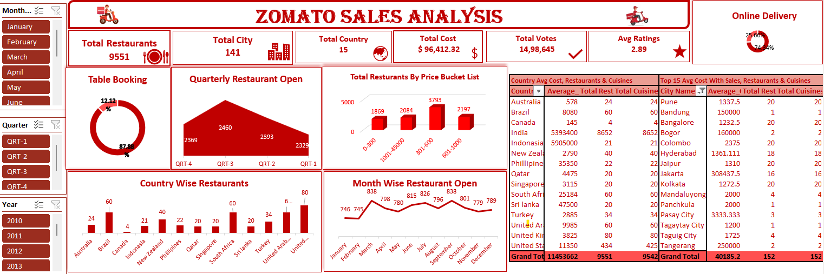

Slide 3
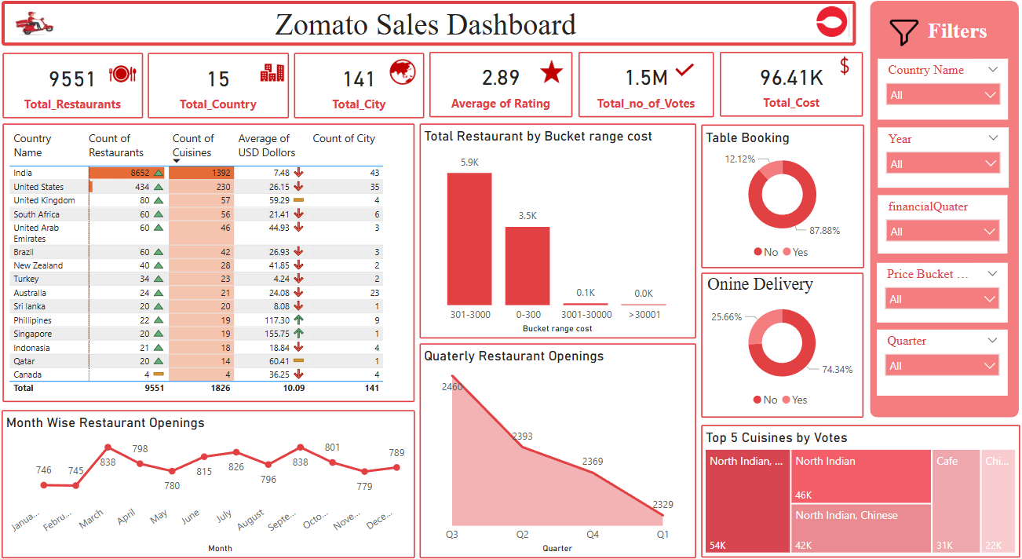

Slide 4
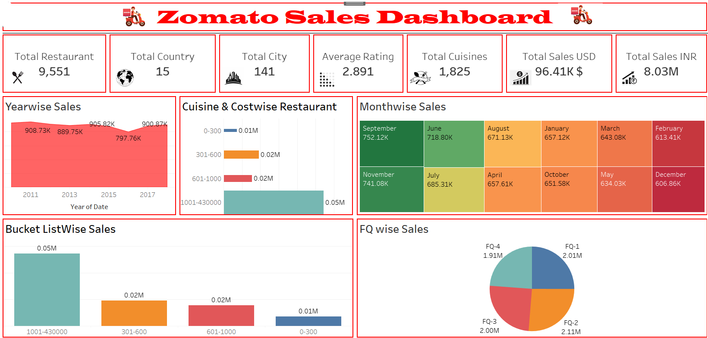

Slide 5
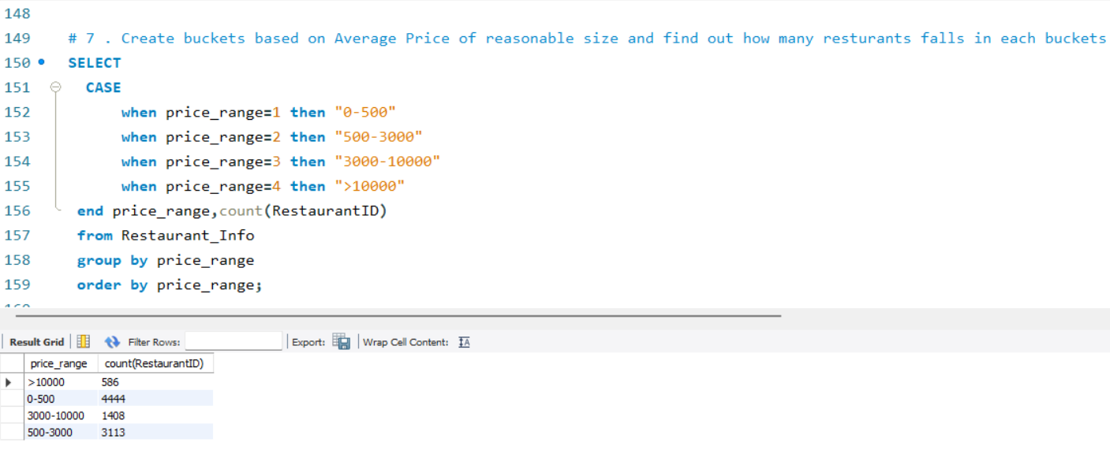
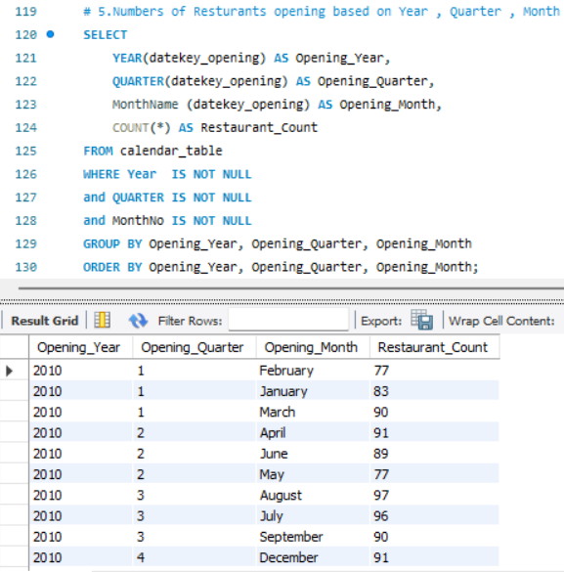
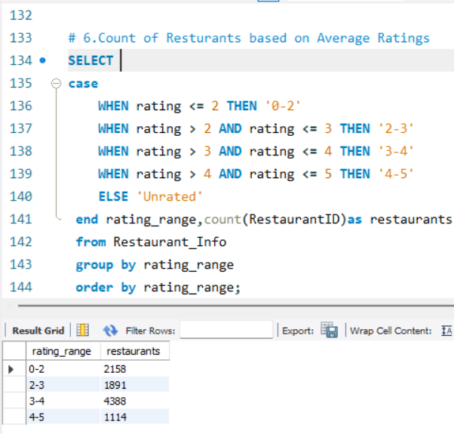

Slide 6
Introduction
This report provides a comprehensive analysis of restaurant data through four key dashboarding tools: Excel, Power BI, Tableau, and SQL. Each tool was used to explore different dimensions of the data, from visual trends to in-depth query-based analysis. These dashboards were designed to uncover insights into restaurant growth over time, customer preferences, pricing strategies, and geographic patterns. Together, they offer a holistic understanding of the restaurant industry, enabling better strategic decision-making for stakeholder.

Slide 7
Conclusion
Rapid Growth: Major urban hubs like New Delhi, Mumbai, and Bangalore experienced a surge in restaurant openings, especially during 2016–2018.
Customer Ratings: Most restaurants are rated between 3.0 and 4.0, indicating generally positive customer feedback with room for excellence.
Pricing Insight: A large portion of restaurants are budget-friendly (under INR 500), although a higher-cost segment does exist with premium offerings.
Cuisine Preferences: North Indian cuisine is the most offered, while Chinese and FastFood options are also widely available.
Deeper Data Exploration: SQL provided advanced insights by creating date-based intelligence (calendar views), rating classifications, and cost buckets.
These dashboards, when combined, deliver a thorough understanding of the restaurant ecosystem—helping stakeholders make informed decisions based on geography, pricing, popularity, and performance trends.

Slide 8
Thank you

